Slide 1
Nature, Woman and Arguments Against the Ordination of Women in ELCL in Latvian Media Discourse
Ilva SKULTE, Kristīne BRIEDE, Sofija Anna KOZLOVA, Emīls ZAVELIS
University of Latvia
The research is funded in the framework of the project "Living and believing gender in a neo-conservative future: the case of women's (non)ordination in Latvian Evangelical Lutheran Church '' by Latvian Council of Science. The research is funded in the framework of the project "Living and believing gender in a neo-conservative future: the case of women's (non)ordination in Latvian Evangelical Lutheran Church '' by Latvian Council of Science.

Slide 2
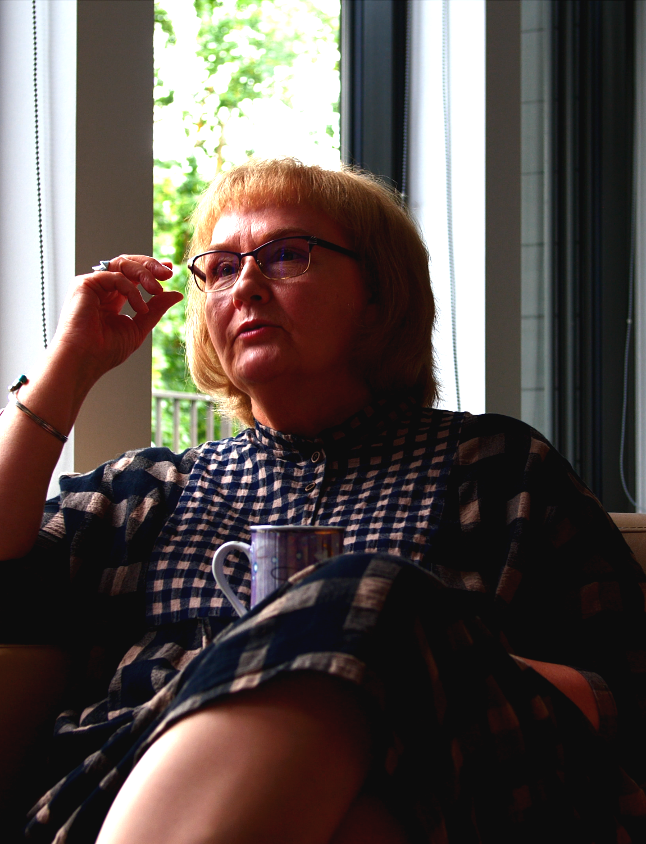
"It is a clear Sunday morning in 1993, and Marika Vidiņa, the deaconess of the Bolderāja congregation and a serving theology student with a special commission from Archbishop Kārlis Gailītis (since 1991), is on her way to Bolderāja to lead a service in her congregation. While sitting on the bus, she opens the newspaper "Sunday Morning" and sees a published announcement stating that, as of today, all permissions granted to consecrate the elements of the Eucharist are revoked…"
"Nobody informed me personally about the revocation of my powers; I read about it in the "Sunday Morning". It is unpleasant that gender issues are being treated in such a primitive way."
Marika Vidiņa, DIENA, 17.07.1998

Slide 3
CHURCH- MEDIA - SOCIETY
PRIVATE SPHERE
CASANOVA, 2009.
CASANOVA, 1994/2011.
HABERMAS, 1991. HABERMAS, 2006. HABERMAS, J 2008.
HURD, 2015.
KALTSAS, 2019
MCIVOR, 2019.
Petzen J. 2012.
SULLIVAN, 2005.
church
PUBLIC SPHERE:
communication and discourse:
politics
state
media

Slide 4
BOURDIEU ON MASCULINE DOMINATION Bourdieu, P. (1996). Masculine domination revisited. Berkeley Journal of Sociology, 41, 189-203.
«Men and women construct the social world, granted, but they do so with forms and categories that are constructed by the world, categories that they neither choose not make and of which they are not the subjects. […] there are social conditions and mechanisms of construction of the constructors, including the State which is the great hidden constructor of agents via mediation of legitimate identities.» (ibidem, pp.199)
«Masculine domination […] is founded upon the logic of the economy of symbolic exchanges, i.e., upon the fundamental asymmetry between men and women insituted in the social construction of kinship and marriage that between subject and object, agent and instrument.» (ibidem, pp.200)

Slide 5
THEORETICAL AND METHODOLOGICAL CONSIDERATIONS: an analysis of discourse
How language is used in social context:
Language analysis oriented towards the text,
+ context that belongs to social situaion or communicative event.
Discourse analysis seeks to investigete link between language
use and social reality.
Miles, B. (2010). Discourse analysis. In N. J. Salkind (Ed.), Encyclopedia of research design. SAGE Publications, Inc., P.368-370. https://dx.doi.org/10.4135/9781412961288.n115
According to Norman Fairclough ------------------------------------------------------------------------→
According to Teun van Dijk
There are «three main dimensions of discourse: 1) language use, 2) communication of opinions or knowledge, also called cognition, and 3) interaction in social situations».
The micro-level of discursive analysis is based on the constructive nature of the discourse or social interaction in a separate text, while the macro-level describes how the discourses found in the text are determined by social problems and social institutions. The text is analyzed by focusing on the executive functions of the language - behind the understanding of the meaning of the text, looking for the orientation of the text towards action."
^{[1]} Rīgas Stradiņa universitāte. Pētniecības terminu vārdnīca. Izgūts no https://www.rsu.lv/petniecibas-terminu-vardnica/diskursiva-analize
sociocultual context
production context
media text

Slide 6
GOAL & RESEARCH QUESTIONS
An analysis of the media discourse on the women ordination in Latvian Evangelical Lutheran Church (ELCL) to understand the “naturalization” of women’s non-ordination in the media discourse as it is performed in the media communication in the period of time between 1992 and 2022
RQs
1) What arguments are used and how have they changed over the years? How have the arguments developed or changed over 30 years of public discussion and the advent of the Internet? Was the logic of Internet communication changing the discourse?
2) How the notions of “nature” and the “natural” are used in arguments with conservative connotations they rise and implicit normative imperatives.
3) What arguments – starting from biological function and character traits coded as naturally masculine – to the complex theology based on natural binarity – were circulated and what kind of evidence was used?

Slide 7
MEDIA MATERIAL SELECTED FOR ANALYSIS
Secular printed papers “Diena” and “Latvijas Avīze” – different audience and ideological context [1992 – 2022];
Online news portals – Delfi.lv and TvNet.lv [1999-2022]
Newspaper “Svētdienas Rīts” of ELCL – audience – Ev.Lutheran community of Latvia –members of congregations of ELCL, pastors, lay people [1992-2022]
Key words:
1: ELCL; Lutheran; Lutheran Church; Evangelic Lutheran Church of Latvia
2: gender; sex, woman, man, ordination

Slide 8
RESULTS: OVERALL – CHANGES IN [SOCIOCULTURAL AND MEDIA] CONTEXT
- Education (initially close cooperation of the Church of Latvia with the Faculty of Theology, which later changed, establishment of new educational institutions);
- Liberalization of the country and politics (establishment of the Union of Christian Democrats in 1994, onwards),
- Interests in theology and Church fluctuations;
- Availability of diversity of opinions in the media (editorial position, increase in media volume, later decline);
- Entry of the LGBT issue into the social and media agenda (initially unrelated to the women ordination, this context appears in argumenta later in overall ideological rooting of the problem);
- Changes in language and lexicon, meaning systems;
- Digitalization of media, new media ecosystem

Slide 9
RESULTS: OVERALL – TEXTUAL LEVEL – WORDING AND ARGUMENTS
In spite of the change of context, there is no change observable in arguments – they are strongly rooted in traditional worldview and conservative perception of social order
The recent wave of neoconservativism in the world as it appears in public communication [language used in media texts] in Latvia might encourage institutionalization of more conservative order in ELCL
The naturality of differences between man and woman and the following arguments against / in favor of ordination are mostly not openly expressed, but taken for granted, because they are part of the conservative/traditional worldview

Slide 10
RESULTS: MEDIA OVERVIEW
SVĒTDIENAS RĪTS | DIENA | LAUKU/LATVIJAS AVĪZE | INTERNET MEDIA [DELFI.LV AND TVNET.LV]
religious clear break in the discourse in 1993, in the center - division, editorial anonymization -submission to ELCL management the ELCL discourse is further implemented | Secular:liberal In the 1990ies stage discussion with many actors and stakeholders, journalists are critical towards ELCL, however, the attention towards authoritative and institutionalized power actually transmit official opinion Fragmented discourse in the 21st century. | Secular: national conservative Little attention to the 1990ies Journalists orient on the balance of opinions, but take conservative worldview as granted = naturalize it | Secular: liberal coverage fragmented and lacks continuity. ​ The interest is sporadic, the discussions often lack depth.
The pro arguments draw upon concepts of gender equality, practical considerations, also and theology​, the counter arguments rely more on theological and traditionalist precepts, as well as references to religious authorities.

Slide 11
RESULTS: CHANGE OF DISCOURSE : SVĒTDIENAS RĪTS
Discourse of Creation
"In the encyclical of Pope John Paul II on the Dignity and Vocation of Women, all the noble and praiseworthy things about women found in the Bible are compiled. And there is a lot of such material, moreover—well-founded. I do not know whether feminists have fully grasped this. The primary vocation of a woman, after all, is to be a mother, a co-participant in the great mystery of life. Such is the will of the Creator."
Discourse of the biological mission
"An ordained clergyman is called in three ways: as a servant, a messenger, and a witness. The first two callings can also be fulfilled by women, but the third one, God as a loving Father does not want to demand or accept from them."
Andrejs Kavacis, Man and Woman in the World and in the Church, “Sunday morning”, 28.09. 1997

Slide 12
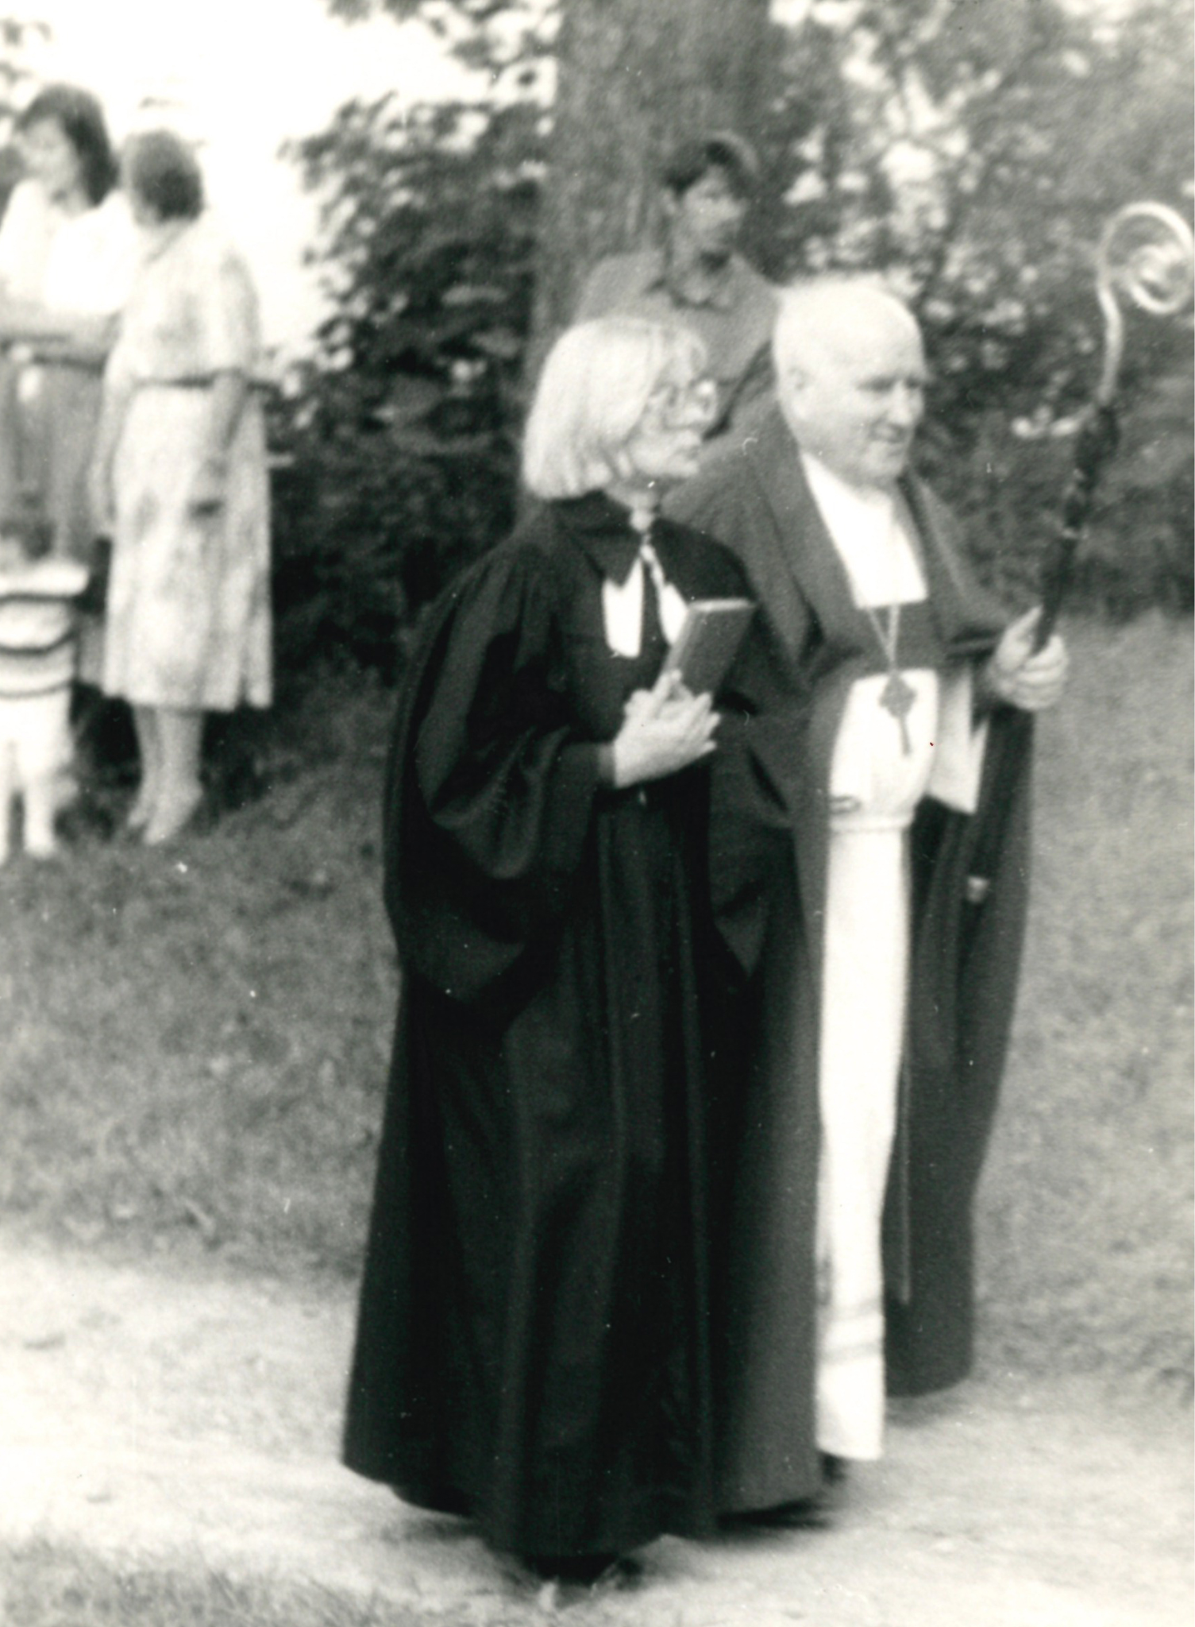
RESULTS: «SVĒTDIENAS RĪTS» [SUNDAY MORNING]
“It is with a heavy heart and a sad mind that I must say goodbye to you today. The pastors' conference, which took place on April 20, fully convinced me that I cannot and, as the debate showed, do not know how to run a Church newspaper at the moment. This difficult time after the Synod, when the editors were "led" by everyone who felt called to it, was an unsuccessful attempt, also with the help of you, dear readers, to provide true and genuine information about the life of the Church. Unfortunately, it turned out to be too difficult a task.”
2.05.1993, Aīda Prēdele, editor in chief
Picture: Pastor (later editor in chief of “Svētdienas Rīts” ) Aīda Prēdele and Archbishop Kārlis Gailītis

Slide 13
RESULTS: FACTOR OF ACTORS
staged personality of Archbishop JĀNIS VANAGS-
well known in 1980ies as an active voice for liberalization of society
Skilled communicator:
References to the Bible, reference to tradition [«we» as conservative society in reaction to Soviet time], denial of explanation of theological argument to the lay audience,
Skilled argumentation, irony, atack on opposition with argument to mix religion with politics
Woman’s inspiration is not real
Objectivity and legitimizing discourse – scientific commission of the Synod
Discourse of unity in the 2000ies

Slide 14
RESULTS: FACTOR OF ACTORS
«The ordination of women is not a "human rights issue" or a "church tradition," nor is it about people's opinions or customs. It is also not a matter of discrimination against women. Various social reformers in our culture want to make us believe that men and women are completely interchangeable and that their God-given differences have no place in modern society. This not only contradicts the clear testimony of nature but also contradicts the Bible. The Bible teaches a different view of God's creation»
Jānis Vanags: Kā ar sieviešu ordinēšanu mācītāja amatā? // 19.02.2014 // https://www.delfi.lv/news/versijas/janis-vanags-ka-ar-sieviesu-ordinesanu-macitaja-amata.d?id=44229423

Slide 15
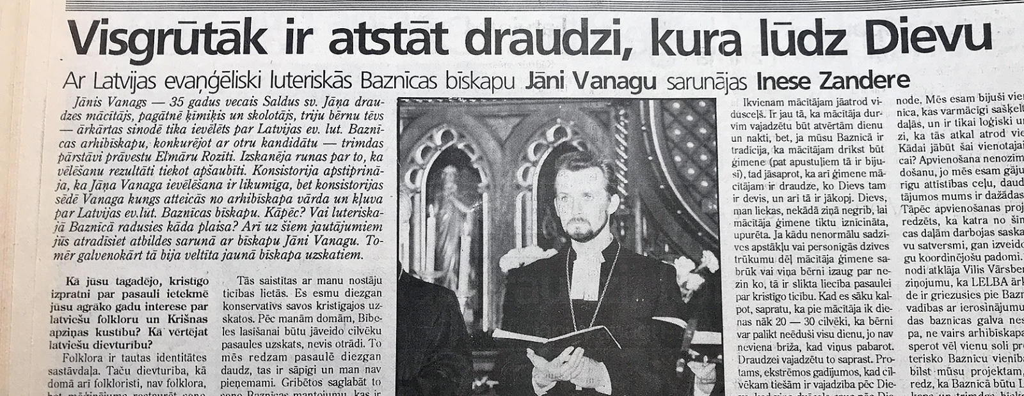
Ideologically saturated, autoritatively formulated as natural
ARCHBISHOP JĀNIS VANAGS
"The family as a model of the relationship between God and people... it is difficult for me to explain everything in one interview, it would require a special article. If God had arranged the spiritual office in such a way that only women would do it, then for me (with my approach to the Holy Scriptures, I can claim this) I wouldn't have the slightest pretensions and I wouldn't try to break into the sphere that is not intended for me. I don't think that it somehow humiliates or discriminates against a woman, because God has given a woman all kinds of opportunities to serve. And nothing should happen in the church out of a desire to prove herself."
“The only obstacle [to the women’s ordination] is my person, because the bishop is ordaining pastors.”
Interview with Archbishop, DIENA, 24.12.199

Slide 16
RESULTS: SECULAR PAPERS: LATVIJAS AVĪZE
Discourse of biological duty
"The Latvian Lutheran Church in its Constitution wants to write that the ordination into pastor’s position is reserved for the men only, but the Church outside Latvia recognises women’s ordination. In reality, the differences between both churches are fundamental enough. Of course, there is a place for rebels in the family of Latvian pastors, the spirit of reformation is allowing it. I think that everything depends on the time and place of education and teachers of the pastors. For example, I had great teachers. It is, of course, possible to discuss, but I support common standpoint of the Lutheran Church. Someone from my brothers in profession said something like this: even if I want to give birth I will not, because I am a man, but if I would manage to give birth to a child, I will not fight to have my rights acknowledged. ”
Andis Lenšs, dean of the district, dean of the Martin Luther Cathedral in Daugavpils, comment in LATVIJAS AVĪZE, 03.11.2015

Slide 17
RESULTS: INTERNET MEDIA DELFI AND TVNET
Discourse of practicalities
Direct references to biological differences are not evident.
Some of the arguments refering to the practical realm might imply an essentialist view of men and women according to which the women are by nature incapable or unsuitable for priesthood.
reference to priesthood being physically demanding
also within the practical arguments in favor of women's ordination there are some that are founded on a similar view naturalizing the differences between men and women - women are more empathic and, thus, are better suitable for at least some of the responsibilities of the priest, i.e., hearing parishioners out. The claims could plausibly be traced back to essentialist views about the differences between women and men being biologically determined.
https://www.delfi.lv/archive/nepazust-tulkojuma-intervija-ar-bijuso-lelb-diakoni-mariku-vidinu.d?id=35543511
https://www.tvnet.lv/5234604/sieviete-macitaja-man-gadiem-krimta-ka-sievietes-latvija-neordine

Slide 18
RESULTS: SECULAR PAPERS: DIENA
Arguments of women pastors, evangelists, theology students -
the discourse of rejection, disappointment, the discourse of injustice
Physical weakness? «At least one gets the impression that they think - God forbid, women will turn out to be more educated, smarter, the congregation will trust them more. Nowhere does it say a woman can't be a pastor because it's hard. Of course, a woman is weaker, but men tend to be weak too, and I wonder if the professions of a lawyer or a doctor are easier.»
Lack of intelligence? "If we accept that when Christ came into the world, the situation has changed radically, then we must be consistent to the end. Why can a man who has graduated from the Faculty of Theology be a pastor, but a woman who has received exactly the same education cannot? The course mates that I have spoken in front of in the exams are now pastors. I consider it a kind of discrimination against women,»
Zaiga Kotāne, DIENA, 17.07.1998

Slide 19
RESULTS: REACTION: RELIGIOUS PAPER: SVĒTDIENAS RĪTS
Reaction of ordained women: violence
"Reading and hearing all this, I feel as if I have received a blow. I feel disappointed in you - knowing your slow and gentle character, I did not expect such violent behavior towards my sisters in Christ. [...] I feel humiliated. I took your words as if I had been told that I was mistaken in my faith, thinking that God was calling me to serve as a pastor.»
(Open letter of the pastor Austra Reine to the Archbishop Jānis Vanags, 1993)

Slide 20
CONCLUSIONS: ARGUMENTS AND CHANGE
The arguments have not changed over 30 years of non-ordination discourse and
- are repeated in almost unchanged form in all 3 types of media – secular and religous, printed and online.
- imply that women ordination is illogical and against laws – laws of reason, laws set by Bible, social norms and laws of nature, which are
mentioned in the context of practicalities of church – connected to the inability of femal (body and spirit);
put in the context of the Story of Creation (God knows the difference between both of His creations),
although symblically coded are connected what Bourdieu calls a materialistic base = woman is and instrument of kinship prolongation understood in the context of economic relations.
Notions of “nature” and the “natural” are NOT often used in the text of arguments, because they are a priori of the conservative discourse, worldview and implicit normative imperatives.

Slide 21
CONCLUSIONS THEOLOGY AND SOCIETY
Society is fenced off by theology and thus from an in-depth public discourse on ordination
Theology as such is linked to conservatism in terms of ideology and values ​​(feminist theology conceptualized as the new, foreign to Latvian society insiders of Latvian Church and misunderstood)
The media, even on a liberal basis, support the arguments of gender equality in the discourse of women's ordination and creating a balanced coverage of the topic, follow the position of power - Archbishop Vanag's opinion is widely represented in the media, he speaks from 1) the position of "we", 2) annihilates the fact of existing ordinations, 3) repels objections to equality as the inapplicability of politics, 4) charismatic/authoritarian.

Slide 22
CONCLUSIONS THEOLOGY AND SOCIETY
The media discourse maintained by media throughout 30 years of independent Latvia on the situation of ordained women pastors is emphatetic, but at the same time marginalizing - they are disappointed, they have left, they are not justified and disclosed, incl. theological arguments also from the supporters of ordination. The media rely on their pre-known discourse preferences, rather than consciously creating their own discourse.
This is how masculine domination is insitutionalized in the context of ELCL and is naturalized in media discourse on non-ordination – by implicating the view of natural differences hidden in the social cognitive categories involved into description of human nature (bodies and qualities) and the treatment of the respective agency.

Slide 23
REFERENCES
CASANOVA, José, et al. A debate on the public role of religion and its social and gender implications. Geneva: United Nations Research Institute for Social Development, 2009.
CASANOVA, José. Public religions in the modern world. University of Chicago press, 1994/2011.
HABERMAS, Jurgen. The structural transformation of the public sphere: An inquiry into a category of bourgeois society. MIT press, 1991.
HABERMAS, Jürgen. Religion in the Public Sphere. European Journal of Philosophy 14 , 2006. 1–25
HABERMAS, Jürgen. Notes on Post-Secular Society. New Perspectives Quarterly 25, 2008. 17–29.
HABERMAS, Jürgen. "The Political": The Rational Meaning of a Questionable Inheritance of Political Theology. In Judith Butler, Jürgen Habermas, Charles Taylor, Cornel West: The Power of Religion in the Public Sphere. Edited by Eduardo Mendieta and Jonathan VanAntwerpen. New York: Columbia University Press, 2011, pp. 15–33.
HURD, Elizabeth Shakman. Beyond religious freedom. In: Beyond Religious Freedom. Princeton University Press, 2015.
KALTSAS, Spyridon. Habermas, Taylor, and Connolly on secularism, pluralism, and the post-secular public sphere. Religions, 2019, 10.8: 460.
MCIVOR, Méadhbh. ‘The Very Outer Limit of Our Jurisdiction’: Religion, Sexuality, and Value Conflicts in English Law. 2019.
MCIVOR, Méadhbh. Human rights and broken cisterns: counterpublic christianity and rights-based discourse in contemporary England. Ethnos, 2019b, 84.2: 323-343.
Petzen J. 2012. Contesting Europe: A call for an anti-modern sexual politics. European Journal of Women’s Studies 19(1): 97–114.
SULLIVAN, Winnifred Fallers. The impossibility of religious freedom: New edition. Princeton University Press, 2005.
van Dijk, T.eum, (1997). The study of discourse. In T. van Dijk (Ed.), The study of discourse. SAGE Publications Ltd. Volume 1. P.1.-34. https://dx.doi.org/10.4135/9781446221884

