Slide 1
Tenets of Neoconservatism: Biological and Theological Versions of Life and Gender in Latvian Evangelical Lutheran Church
Aivita Putniņa, University of Latvia

Slide 2
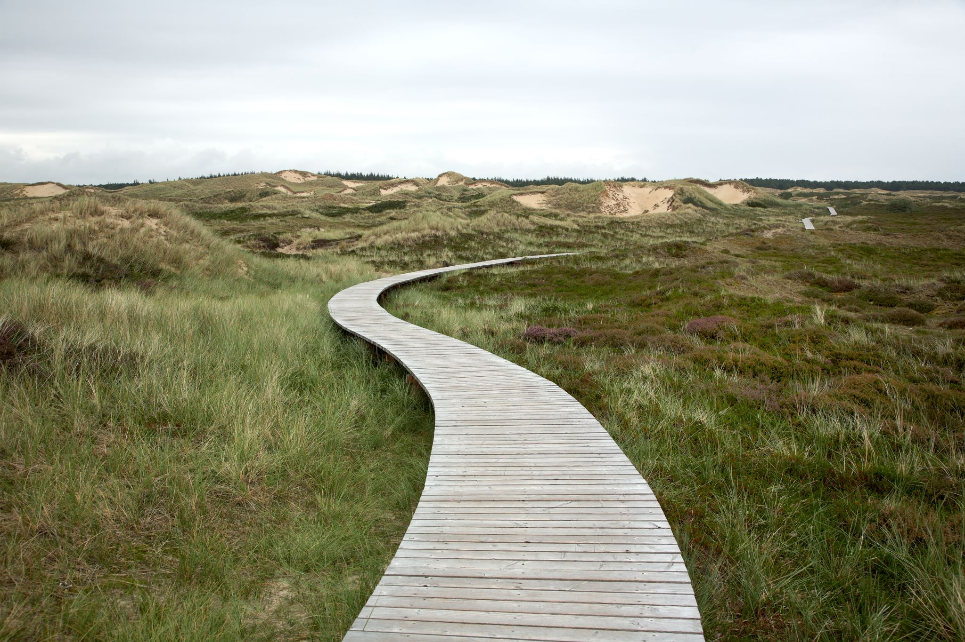
Nature in our culture
Can be imagines
As created by God;
As created by biology.
Those who preach that marriage is being politicised, have themselves been born into a natural [family]. In that sense, I even call it [the family] natural, but I should have really said as a pastor that it simply is a Christian, a Biblical, and a God-ordained order. We have all come in [to this world] according to God’s appointed order. (Pastor Olafs)

Slide 3
“Sexual mythologies of everyday life”
what is being said about men and women, and how their relationship is symbolised;
description of behaviour, action, social structure, etc.;
how gender stands for other things and relations. (Strathern, 2018: 286).
=> Nature and gender mythology

Slide 4
Table 1. Code-Document cross-table.
Categories | Lay people (65) | Pastors (58) | Women (45) | Men (79)
“Nature”, “natural” in biological context | 40 | 42 | 23 | 59
“Nature”, “natural” , “ life” as God created entity, order | 3 | 21 | 1 | 23
“Life” in biological context | 7 | 28 | 7 | 28
Procreation, “natural” family based on it | 14 | 28 | 12 | 30
Gender difference seen as a cultural difference |  | 3 | 1 | 2
 | 61 | 121 | 43 | 141

Slide 5
“Nature” backing up God in positioning women
We are not created to say mom1 and mom2 or dad1 and dad2, as in today’s world, but that’s not how people were created. Then the organs that distinguish us should also be ignored—cut off or sewn on. It is so purely natural. From nature, it has gone that way. I believe that it is completely people’s own attempt to build some kind of fairy tale. On the one hand, as if they want to make everything the same, on the other hand, to separate. (Pastor Boriss)

Slide 6
The pastor is like a lightning rod in the middle. An instrument in God’s hands. If the tool is weak, he can easily burn out. If the current is high, the sin is heavy, and it is possible that the pastor has the same temptation, then it is very difficult for him to eliminate it. And as a result, women are mentally stronger than men, also live longer, as we know. (..) However, it is not their job to deal with such a dirty task. Let us put it this way: the task is sacred, but life-threatening. Only from this point of view, I do not recommend women to take on such a task, but let's say, to teach—yes! Wonderful teachers. (Pastor Rodrigo)

Slide 7
Well, those contemporary [issues], against which the church always raises its voice and protests—abortion, euthanasia, all regarding life, the sanctity and inviolability of life—follow from the fact that life belongs to God. The issue of homosexual relations is different from the way society tries to interpret it. It clearly indicates that homosexuality is a sin, and here they try accusing the church... By the way, also in the case of not ordaining women, it is the same thing – [it is said] that the church somehow humiliates women or despises them, and the church humiliates homosexual people. Absolutely not, absolutely not, because the church treats every person with respect, but will always condemn actions that the Holy Scripture qualifies as a sin. (Pastor Indulis)

Slide 8
Male—female difference
A woman.. She has a mission that a man can only dream of. To give life. A woman can create life, that is something. I, for example, do not have this blessing. (..) And I think there are so many ways a woman can serve, in all kinds of ways. So why at any cost... do you need exactly that [being ordained as priests]? Yes, to break in. And [break in] not only in the church but in many other areas. At all costs, it is necessary to break into the fields of men [stressing these words]. (Brigita and Eleonora )
And you realise that one cannot be a leader since it requires time to always stay at a certain level. (..) A woman gives birth to children and then she has no time at all [for this]. (Vitauts)

Slide 9
A woman is a complete creation. That’s the rib [taken out from Adam]. That's why I laugh, not that men are the strong sex and women are the weak one, but vice versa. Biologically, a man is weaker than a woman, although he may have more muscle power.(Pastor Tālis)
God has established that a woman is the weaker sex, so God’ word speaks. God wanted to give birth to children through a woman. (..) God has put this tenderness in a woman and a man will never be able to take on this responsibility that God has put in a woman. Also to give birth to children. In any case, a woman spends at least nine months longer with a child than a man. That's like a minimum. And even after that... It cannot be the case, let us say, that a woman is given the same [means of] expression as a man. This is not the case. And it is precisely in our time and the time before that the emphasis is placed on the fact that a woman should be... I would not even say equal to a man, but I would even say superior to a man. The way I see it, the tendency is now for a woman to prove that she can do what men have done historically, with a higher quality, better, and so on. (Pastor Toms)

Slide 10
‘Natural’ family, mothers, and fathers
- I feel really good when I am allowed to say the final word on what we are going to do [in the family]. I feel so cool, oh, I feel so praised.
Q: Because in some decisions do you have the final word?
Yes, yes, and then it seems to me that the natural thing comes, therefore, I have even greater... one could not say, even greater love, but I want to show that love to my wife even more, [then] it is even easier for my wife to delegate me the choice, and restrain from making decisions herself. (Justs)
Now, the pastor can address the children in Sunday schools. I have taught them too, which is terribly difficult for me. Now .. perhaps, you heard me now [talking in the Sunday school], it is just natural. But at first, I thought, well, what would I say to those young people. You must remember what you were [at that age]. (..) There is no need to complicate anything. They are mature humans like anyone else. And the role of a woman in the church, I would say, of course, a woman would always wash the church floor better and neater, and the men would do it worse. (Pastor Indars)

Slide 11
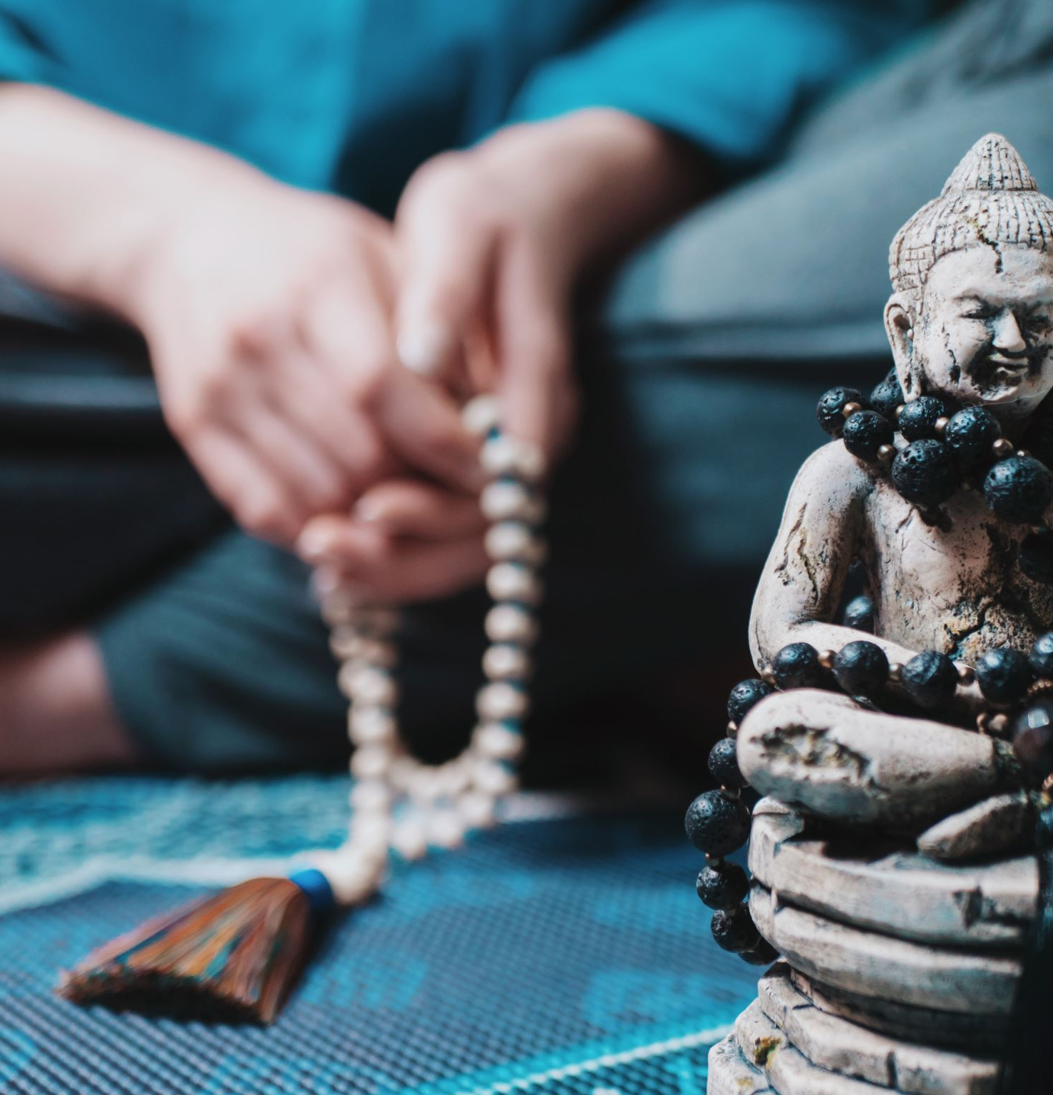
As a man, can I also give birth? I cannot. God did not give it to me. These are primitive things that are self-explanatory. A commandment that is written in my heart—I think that things that a man should do are written in there. For example, my wife will not carry the firewood; I would [do it]. It's not like it's written, but it is so… (Ēriks)
God has arranged it so that the pastor’s position is for the man, and the woman is the mother. She has an even bigger task. She must give birth; God’s children must be brought into the world. It’s even more! A man can't do that. (Edgars)

Slide 12
Ambivalence of gendered division of labour and directionality of gender
Well, I cannot iron and cook at the same time, and one of those two things would fail. And women, they can somehow. She takes care of the child with one hand, and with the other she is ironing, but with her shoulder she is holding the phone and, somehow, those women can do it. Therefore, they serve as secretaries. For example, our bishop’s secretary left for maternity leave, and the dean was entrusted with the secretary’s duties until a new secretary was found. It was misery and sorrow. (Pastor Valfrīds)
And the fact that a woman is a mother, when she has those maternal instincts inside, and sometimes, unfortunately, they usurp their motherhood to some weaker men as well [laughter can be felt in the voice]. Instead of being wives or girlfriends, they turn to be mothers. (Pastor Valfrīds)
A very natural difference. Because we, girls, have emotions. But God’s word must be brought so clearly that there can be neither tears nor... Not because there cannot be crying, but we cry throughout the service, we cry on our own. (Rita)

Slide 13
Conclusions
Gender in biologically and theologically framed mythologies;
18th century natural science supports the conservative theology:
=> Positioning men and women and producing a hierarchy of relations;
Change in gender relations threatens the union between Enlightenment period biology and theology and the threat of “culture”: to keep power relations one needs a particular kind of biology.

